Slide 1
Dissemination of research findings
Dr. Muna Alharbi
Assistant Professor, Faculty of Nursing, Umm AlQura University
RN, MN, PhD, Nursing Education

Slide 2
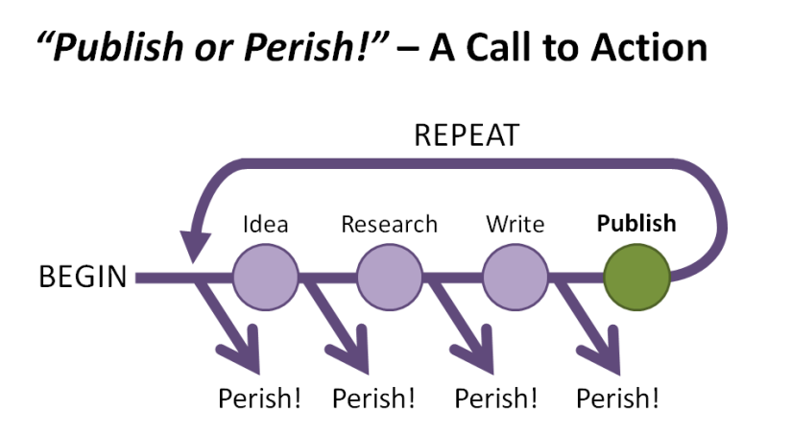

Slide 3
Research not published is research not done!
Notes:
Research is not complete unless it is written up and the findings have been communicated to others. Communication of research findings is the final and one of the most important steps of research process.

Slide 4
Why are you need to publish?

Slide 5
Why do we need to publish?
Requirement for graduation (PhD)
Requirement for promotion (faculty members)
To be recognized in the field/subfield of research
To disseminate knowledge
To get higher accreditation level (college and university)

Slide 6
Typical Mindset post-publication
I need to publish another article
Researchers will cite my work, its good because it is published, is it right?
The journal and the publisher will see that my article is seen by many people and will be cited.
I chose good journal; therefore, my article should be distributed.

Slide 7
The research cycle

Slide 8
The outlines in this presentation
Selecting appropriate journals
Steps of publication in international journals
Writing research manuscripts

Slide 9
Tips of disseminating research findings
Select the audience.
Select methods of communication.
Avoid technical jargons.
Do not overload presentation.
Prepare systematically.
Effective writing.

Slide 10
Methods of communicating the research
Communication of Research Findings
Written
Thesis
Journal Article
Verbal/Oral
Platform Presentation
Poster Presentation

Slide 11
Factors in choosing the Right Journal for Publication
Aim and scope of the journal
Journal Impact Factor
Indexing of Journals
Peer-Reviewed Journals
Publication time
Acceptance rate
Reach of Journals
Check the Journals for any publication similar to your research article
Check for the Journal’s Restrictions
Beware of Predatory Publishers

Slide 12
Where will you publish your research?
BMJ
Elsevier
Wily online
Johns and Taylor
…?

Slide 13
Six tips for adapting and sharing your research findings
1. Know your audience and define your goal
2. Collaborate with others
3. Make a plan
4. Embrace plain language writing
5. Layer and Link
6. Evaluate your work

Slide 14
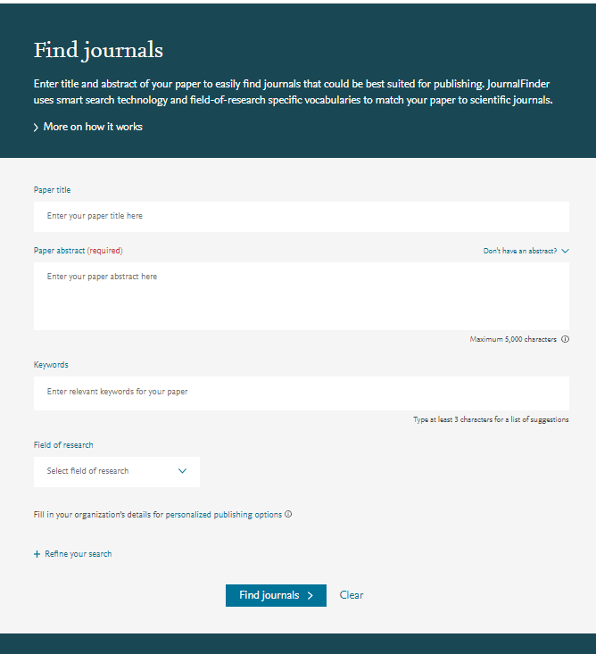
Journalfinder
It uses smart search technology and field-of-research specific vocabularies to match your paper to the most appropriate scientific journals in a few simple steps:
1) Enter the title and abstract of your paper
2) Find journals that are best suited for your publication
3) Ultimately, the editor will decide on how well your article matches the journal

Slide 15
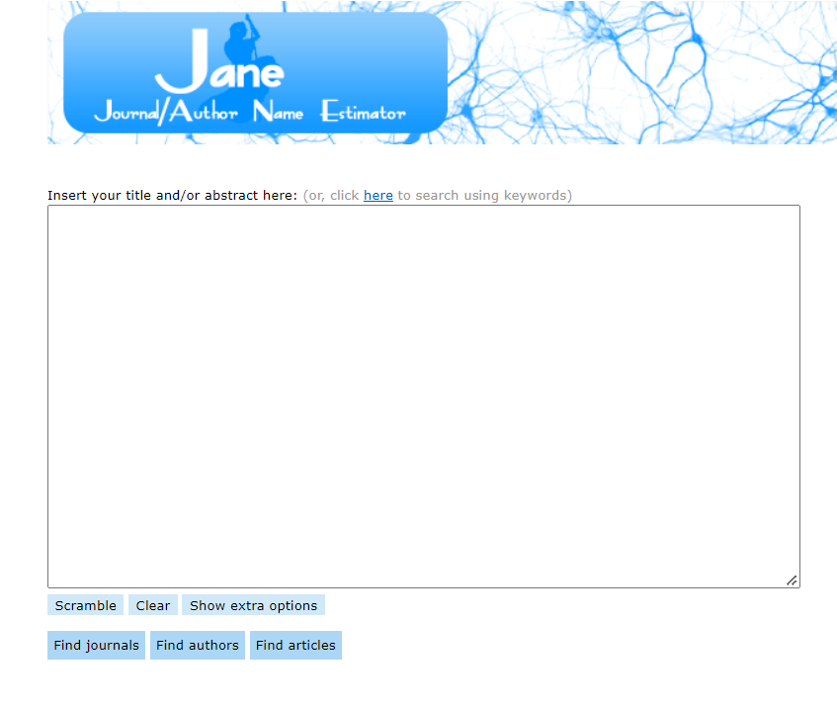
Jane Journal/Author Name Estimator

Slide 16
Tips to get even closer to the perfect journal for you:
Read the journal’s aims and scope to make sure it is a match.
Check whether you can submit an article – some journals are invitation-only.
Use journal metrics to understand the impact of a journal.

Slide 17
Journal metrics

Slide 18
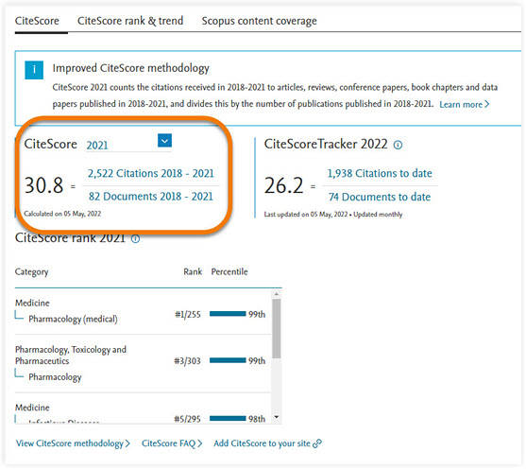
CiteScore metrics
Notes:
CiteScore metrics – helps to measure journal citation impact. Free, comprehensive, transparent and current metrics calculated using data from Scopus®, the largest abstract and citation database of peer-reviewed literature.
CiteScore is a means to measure the average citations for a journal. This is calculated by the number of citations within the past three years divided by the number of all items published in the same years. The higher the CiteScore, the more valuable the journal is deemed to be. All documents that are indexed by Scopus are in CiteScore, including not only articles but letters, notes, conference papers, and reviews. CiteScore is calculated on an annual basis and shows the average citations for a full calendar year. The CiteScore metrics includes eight indicators: CiteScore, CiteScore Tracker, CiteScore Percentile, CiteScore Quartiles, CiteScore Rank, Citation Count, Document Count, and Percentage Cited.

Slide 19
SJR or SCImago
Notes:
SJR – or SCImago Journal Rank, is based on the concept of a transfer of prestige between journals via their citation links.

Slide 20
Journal Citation Ranking and Quartile Scores (Q1-Q4)
Based on Impact Factor (IF) data, the Journal Citation Report provides yearly rankings of science and social science journals, in the subject categories relevant for the journal.
Quartile rankings is quartile of the IF distribution the journal occupies for that subject category:
Q1 denotes the top 25% of the IF distribution,
Q2 for middle-high position (between top 50% and top 25%),
Q3 middle-low position (top 75% to top 50%), and
Q4 the lowest position (bottom 25% of the IF distribution)

Slide 21
JIF- Journal Impact Factor JCR- Journal Citation Report
Notes:
JIF – or Journal Impact Factor is calculated by Clarivate Analytics as the average of the sum of the citations received in a given year to a journal’s previous two years of publications, divided by the sum of “citable” publications in the previous two years.
Journal Citation Reports™ (JCR) provides you with the transparent, publisher-neutral data and statistics you need to make confident decisions in today’s evolving scholarly publishing landscape, whether you’re submitting your first manuscript or managing a portfolio of thousands of publications.

Slide 22
Journal Impact Factor (JIF) is calculated by Clarivate Analytics as the average of the sum of the citations received in a given year to a journal’s previous two years of publications, divided by the sum of “citable” publications in the previous two years.
Journal Citation Reports™ (JCR) provides you with the transparent, publisher-neutral data and statistics you need to make confident decisions in today’s evolving scholarly publishing landscape, whether you’re submitting your first manuscript or managing a portfolio of thousands of publications.

Slide 23
Limitation of JIF
Self-citations
Many times, editors insist that authors cite works in that journal
Some disciplines tend to cite more than others
Journals change their names thus affecting impact factor for approximately two years
Does not consider negative citation

Slide 24
ISI: Institute for Scientific Information
How to Find ISI-indexed Journals
Go to: https://mjl.clarivate.com/home
ISI Master List
Write Journal Name or ISSN number (most of the time) of any journal to check its in the ISI database or not

Slide 25
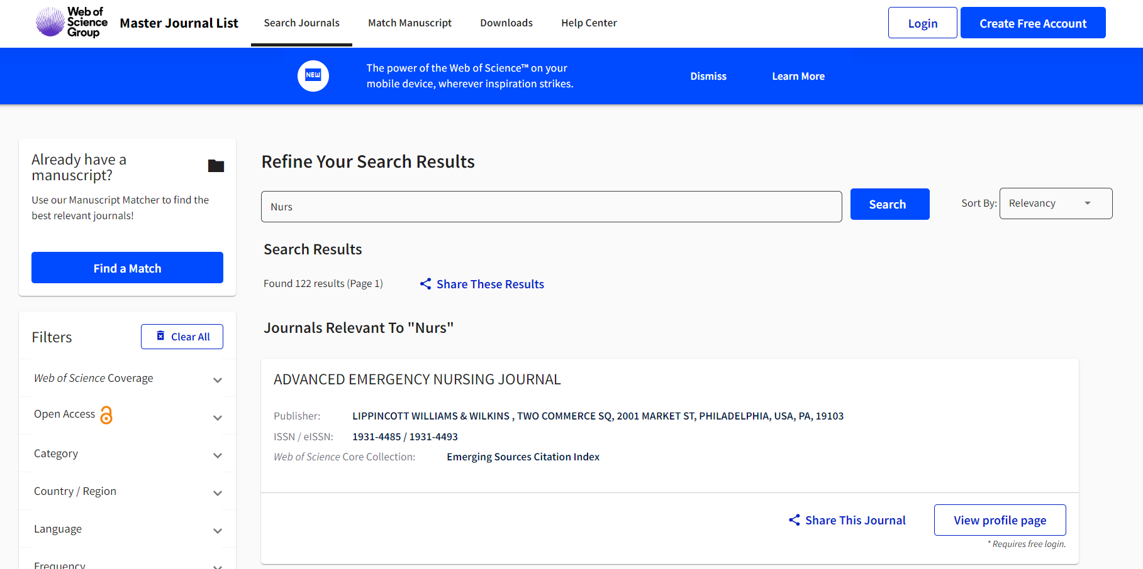
ISI in Web of Science

Slide 26
How do you identify trusted journal?
When deciding where to publish your research paper, you will want to avoid predatory publishers. “Think. Check. Submit.” will remind you of some basic steps to consider in journal selection. The website offers a checklist, that will help you to assure that a particular journal can be trusted: https://thinkchecksubmit.org/

Slide 27
Are you submitting your research to a trusted journal?
Is it the right journal for your work?
More research is being published worldwide.
New publishers are launched each week.
Many researchers have concerns about predatory publishing.
It can be challenging to find up-to-date guidance when choosing where to publish.

Slide 28
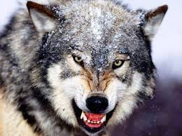
Predatory journal characteristics
A journal title which can be easily confused with another journal
Very wide scope
Displays of unofficial impact factors
False claims of being indexed in major services like PubMed
No publisher address or contact information
Unclear ownership of the journal
Spams researchers with many emails inviting submissions, often unrelated to expertise
Advertises very fast times from submission to publication
Publishes out-of-scope articles
Publishes nonsense articles
Poor or non-existent editing of articles (many spelling mistakes or very poor grammar)
Hides information on charges
No editorial board is listed, or dead or retired scholars or scholars who are not specialized in the topic
Lack of information on the policies of the journal, such as peer review, licensing and copyright

Slide 29
Reference this list for your chosen journal to check if it is trusted.
Do you or your colleagues know the journal?
Can you easily identify and contact the publisher?
Is the journal clear about the type of peer review it uses?
Are articles indexed and/or archived in dedicated services?
Is it clear what fees will be charged?
Are guidelines provided for authors on the publisher website?
Is the publisher a member of a recognized industry initiative?

Slide 30
If you can answer ‘yes’ to most or all of the questions on the list.
Complete the checklist and submit your manuscript only if you can answer ‘yes’ to most or all of the questions above.

Slide 31
The Dos of Journal Selection
Take the time to investigate options that may be new to you.
Choose your first and second choice journals with care, taking the needs of your readers and funders for this specific study into account, as well as the type of article you’ve written, and journal scope and requirements.
Watchout for potential predatory journals that charge fees without offering reliable peer review.
Discuss your needs and priorities with your coauthors and achieve consensus about your submission choice.

Slide 32
The Don’t of Journal Selection
Submit the same study to more than one journal at the same time.
Submit to journals that do not publish your type of study or article.
Just submit to the most prestigious journals in order (e.g. top general science journals, top journals in discipline, others).

Slide 33
Journal publication time

Slide 34
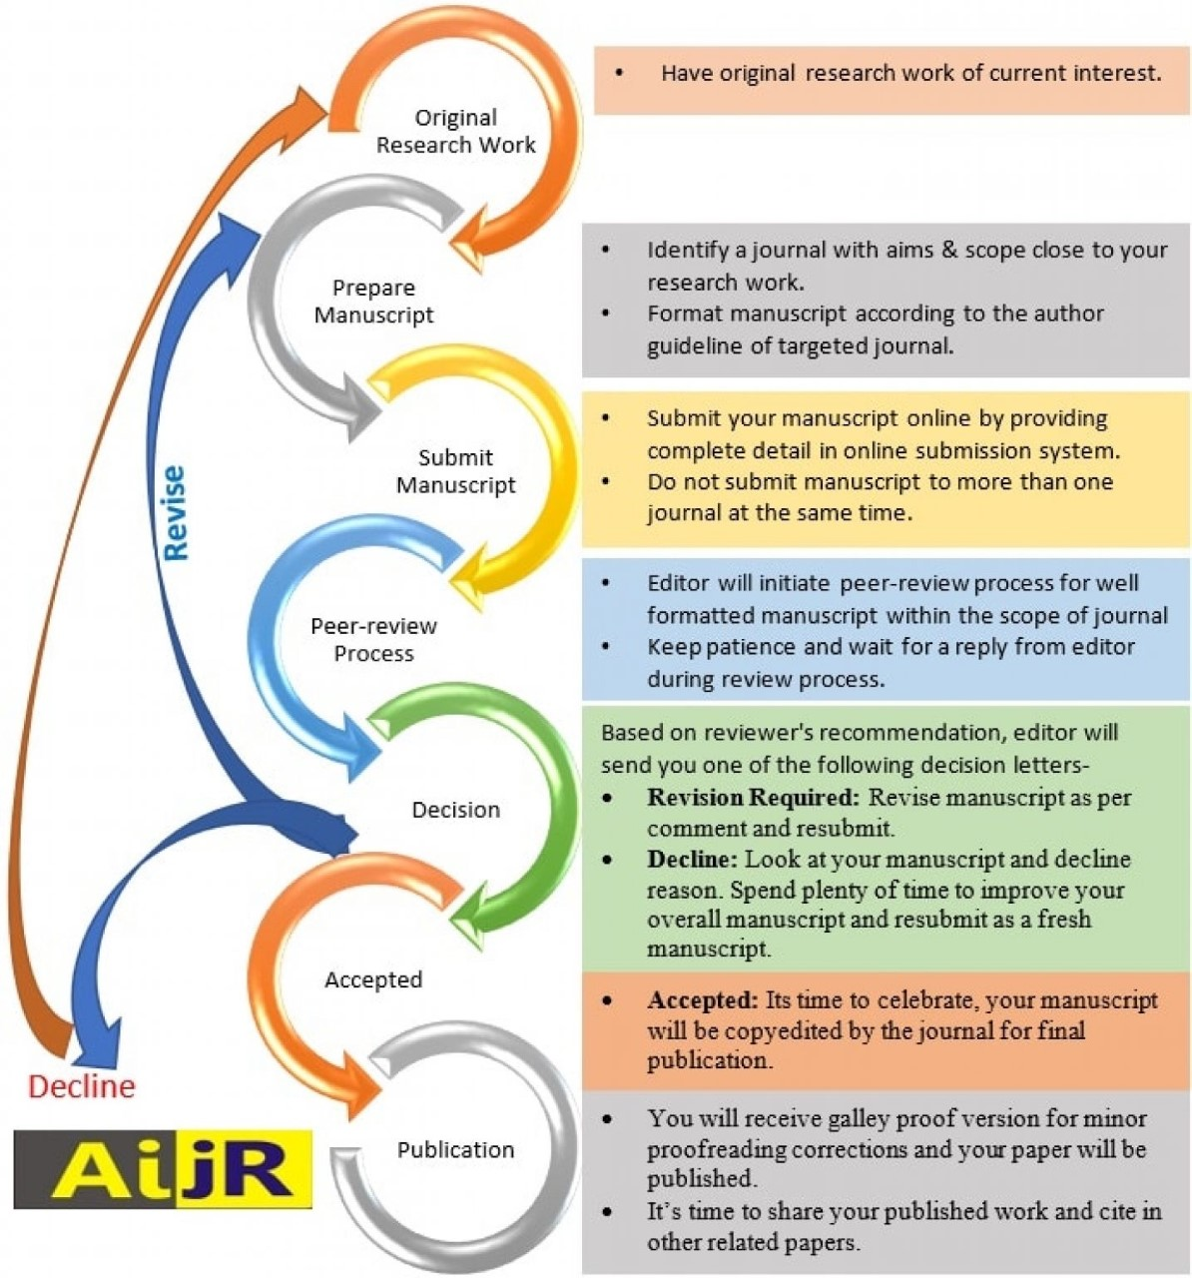
Process of research publication

Slide 35
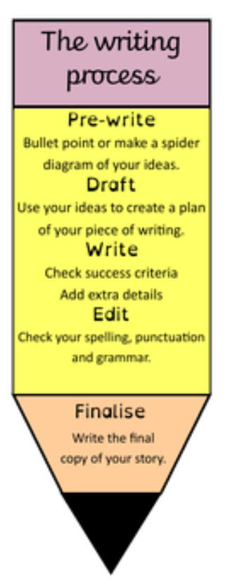
Strategies for effective manuscript writing

Slide 36
IMRD Manuscript structure

Slide 37
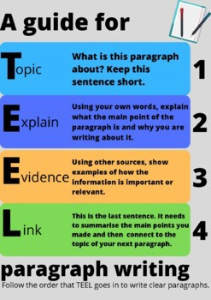
TEEL strategy for writing an academic paragraph

Slide 38
Avoid writing research misconduct FFP

Slide 39
Useful website for writing your paper
Grammarly
QuillBot (paraphrasing)
Phrasebank websites examples:
Academic Phrasebank | The University of Manchester
Useful Phrases and Sentences for Academic & Research Paper Writing - Ref-n-Write: Scientific Research Paper Writing Software Tool - Improve Academic English Writing Skills

Slide 40
11 steps to structure a science paper editors will take seriously
Prepare the figures and tables.
Write the methods.
Write up the results.
Write the discussion.
Write a clear conclusion.
Write a compelling introduction.
Write the abstract.
Compose a concise and descriptive title.
Select keywords for indexing.
Write the acknowledgement.
Write up the references.

Slide 41
Structure of Manuscript

Slide 43
Author Guidelines
The article title should include the research question and the study design. Titles should not declare the results of the study.
A structured abstract (max. 300 words)
objectives:
design:
setting:
participants:
interventions:
primary and secondary outcome measures:
results:
conclusions:

Slide 44
Author Guidelines
Please include a ‘Strengths and limitations of this study’ section after the abstract. This section should be no more than 5 bullet points
A funding statement
A competing interests statement.
Articles should list each author's contribution individually at the end
Any checklist and flow diagram for the appropriate reporting statement, e.g. STROBE (see below).
A data sharing statement
Word count
Supplementary and raw data

Slide 47
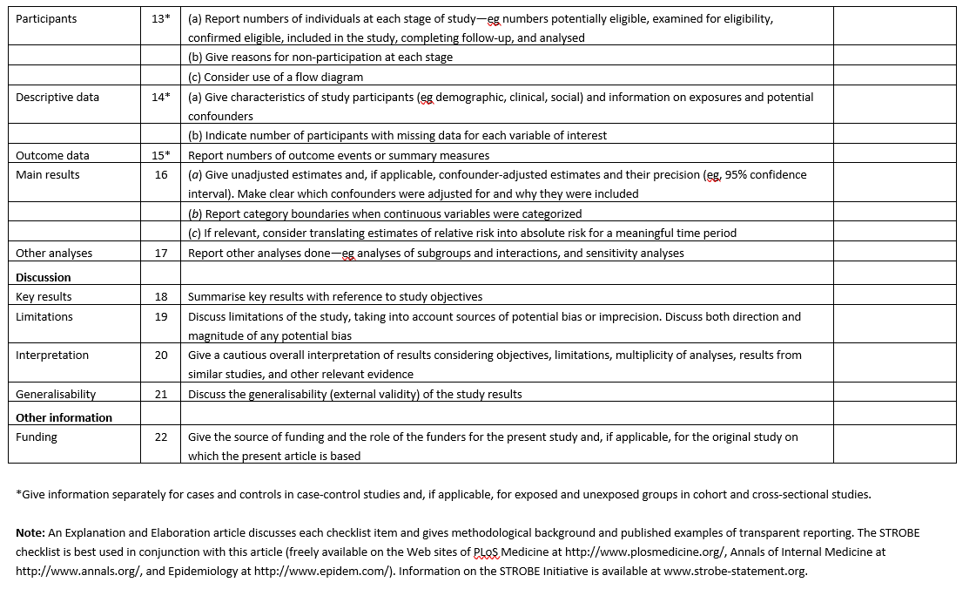

Slide 48
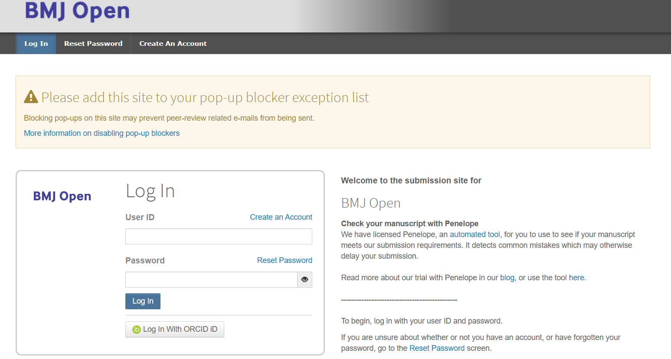

Slide 52
Muna’s recommendations
Title: It should be concise and contain the topic and the design of the study, not more than 12 words.
Abstract: Follow the structure of the journal.
Background/ literature review: Cite article published in the last 10 years, more than 10 references. Different countries!
Aim: It is often written in the last paragraph in the review section. The review should indicate the significance of the study to lead to the aim of the study.

Slide 53
Muna’s recommendations
Methods: This is very important part and carefully revise the reporting guideline to make sure you write everything the reviewers will question.
Results: should be very detailed and logically organized. Should start with demographic data, then simple results, then complicated results.
Discussion: Start the discussion with restating your study aim. In each paragraph state you result, then compare it with other studies, then write your analysis and conclusion of the paragraph.

Slide 54
Muna’s recommendations
Conclusion: This part should not aim to summarize the results. It should state the significant of the results and what is the addition to body of knowledge. Also, it highlights what further research can be done in this area.
References: Need to be organized very often, use EndNote or any reference manager. More than 30 references are recommended in the paper.

Slide 55
How to increase your published article dissemination?
Write a summary of the article in a blog post.
Share a link of your published article on your social media accounts.
Create a video abstract for your article.
Create an infographic about your research
Share your conference presentation slides on slide share
Local/national news outlets.
Present your work to your colleagues, at events, at industry or workplace.
Create your researcher’s IDs.

Slide 57
ResearcherID is a unique identifier to enable researchers to manage their publication lists, track citations and h-index, identify potential collaborators and avoid author misidentification.

Slide 58
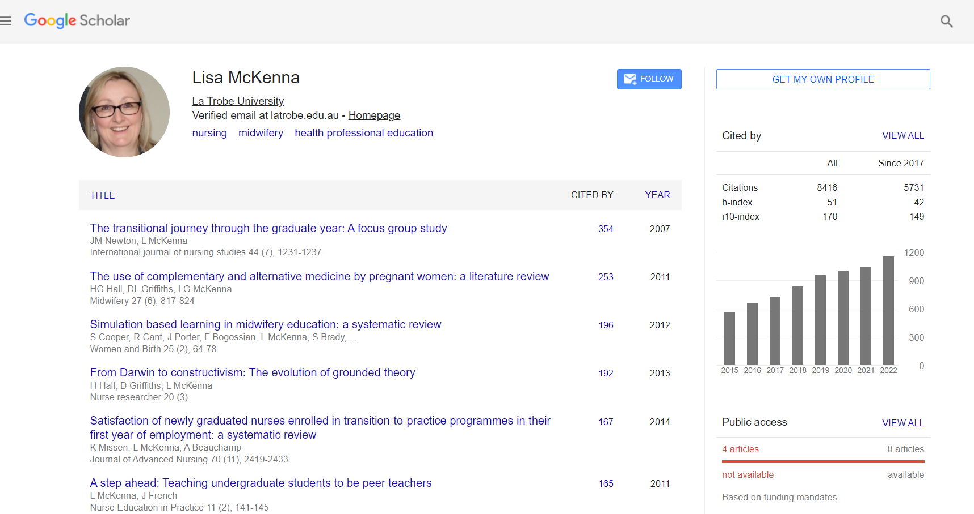

Slide 59
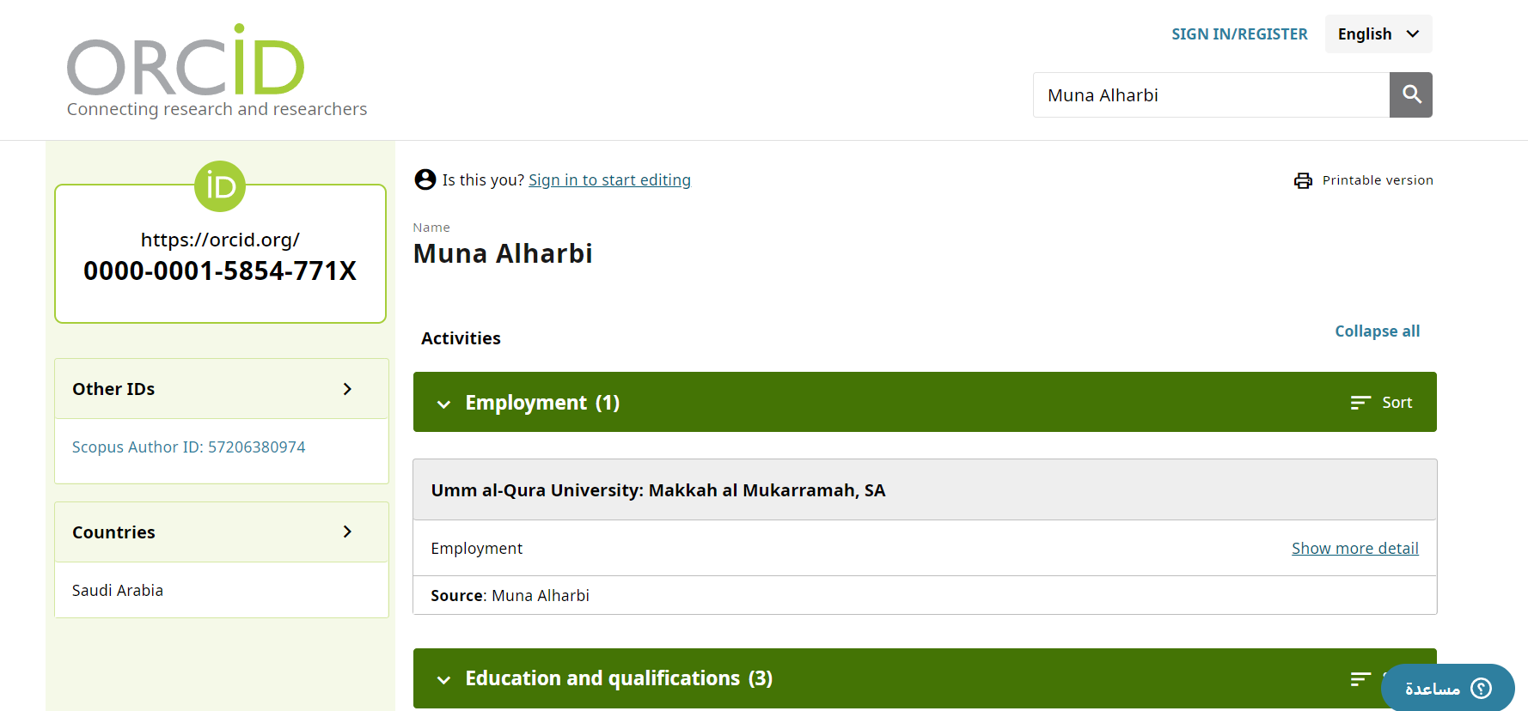

Slide 60
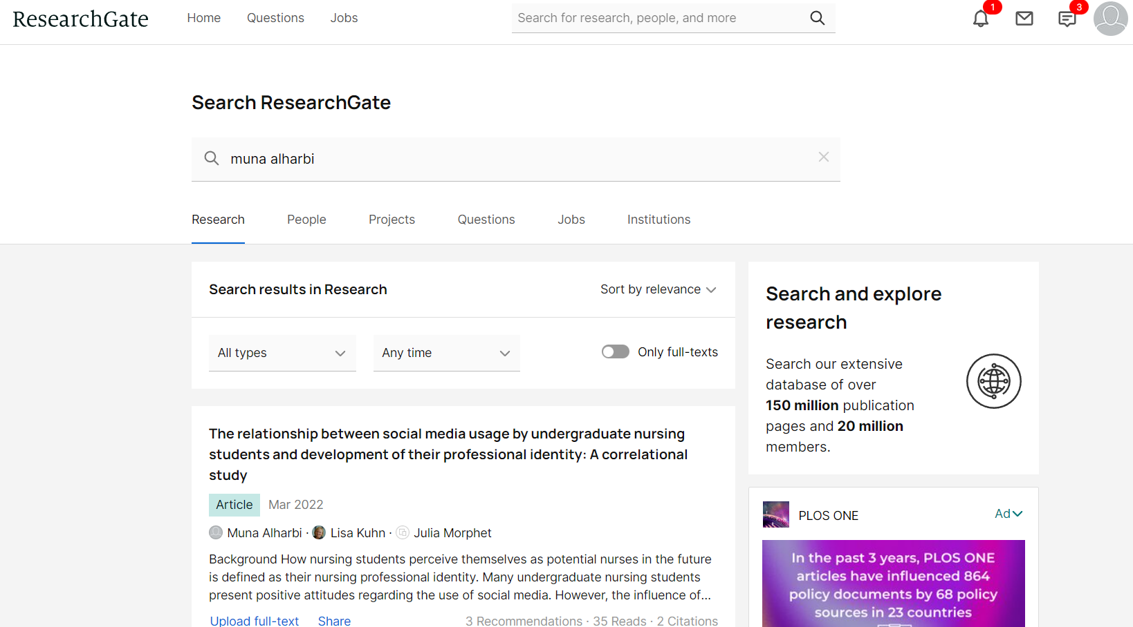

Slide 61
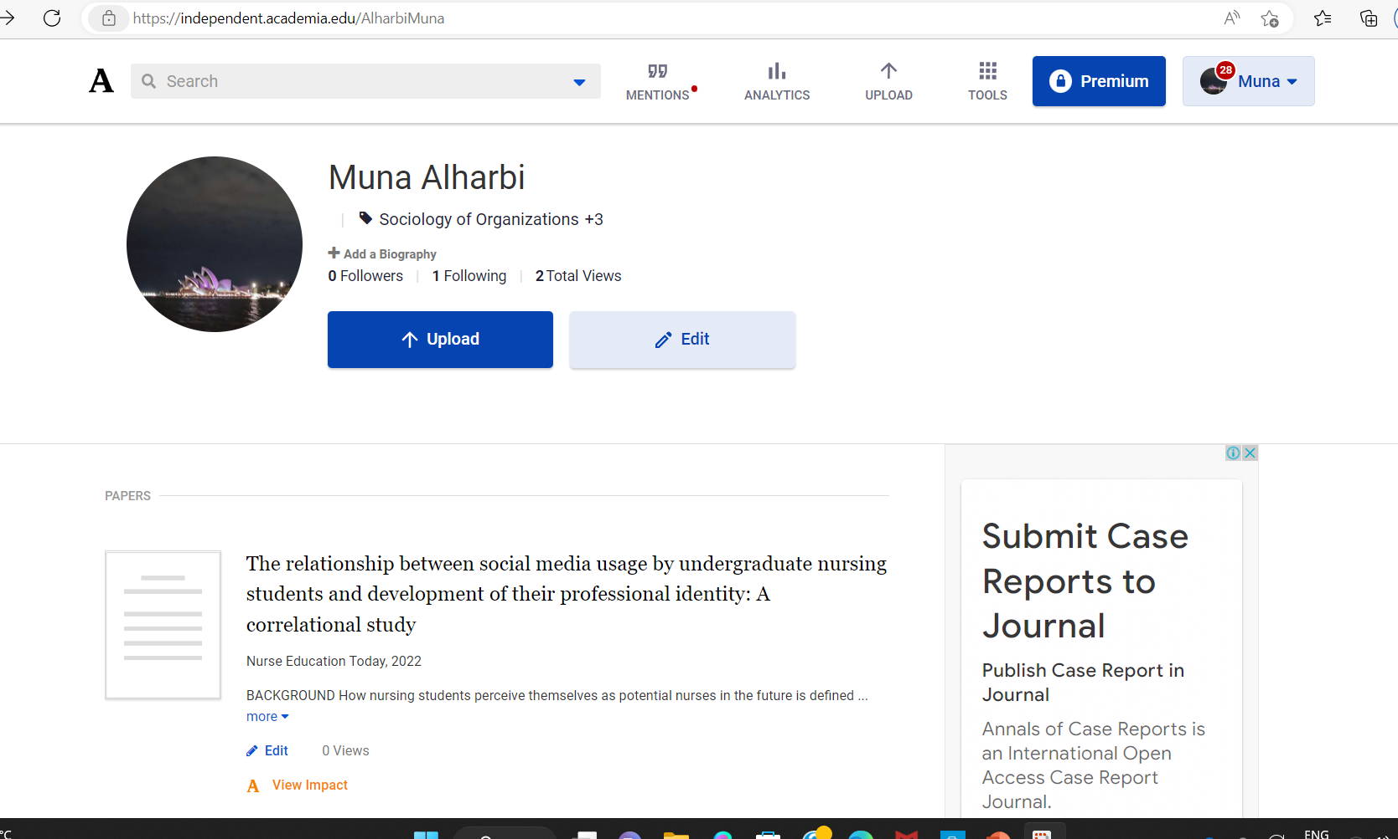

Slide 62
The happiness you feel after your paper is published is deserved ! Then all the tiredness you feel during your research process will relieve 😌

